Slide 1
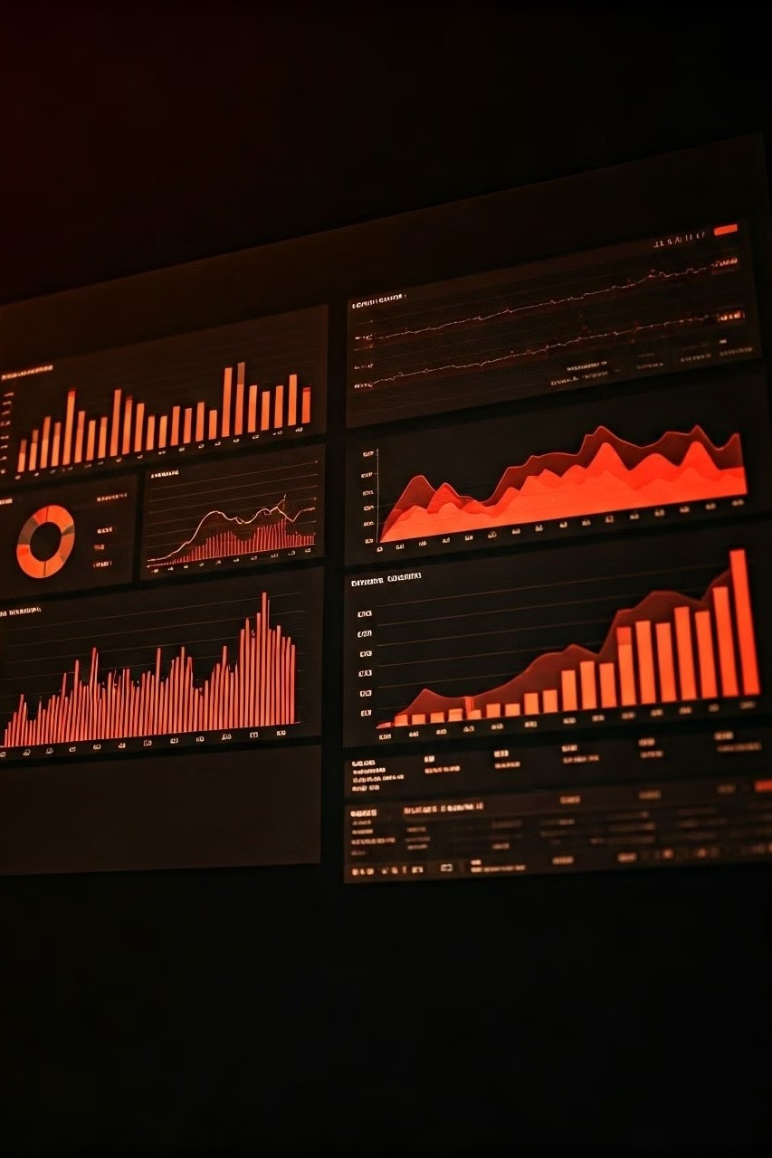

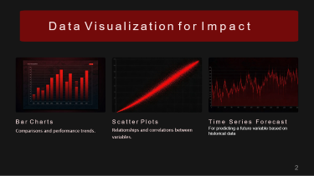
Business Data Management
Mastering data analysis and visualization to solve complex business problems.
by Shusmit Sarkar ( 23f3002196 )

Slide 2
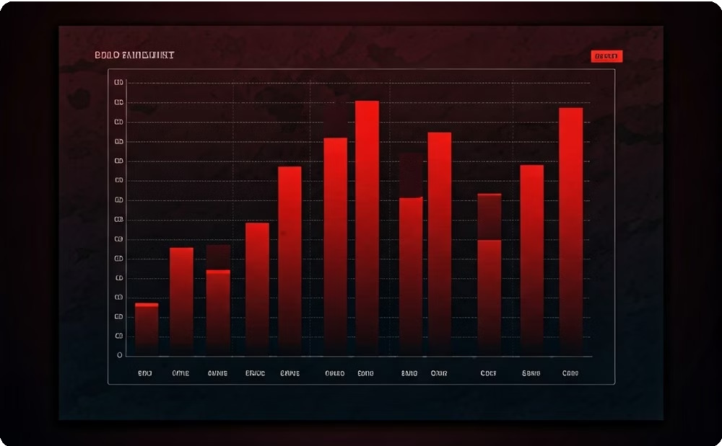
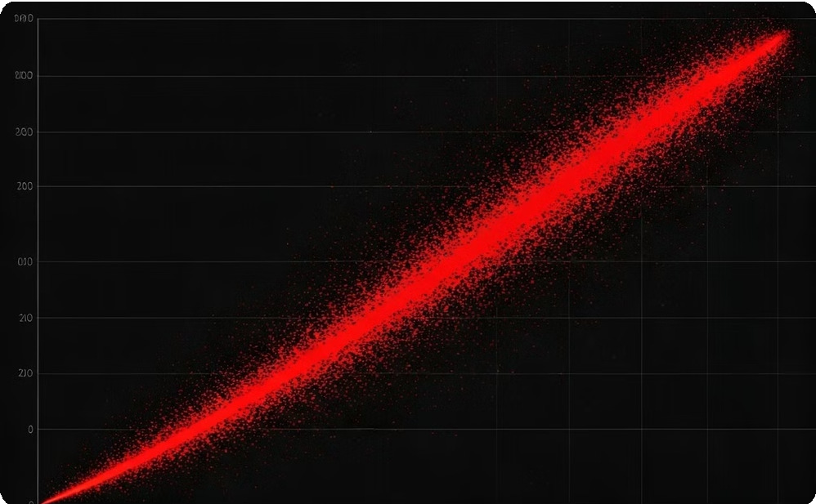
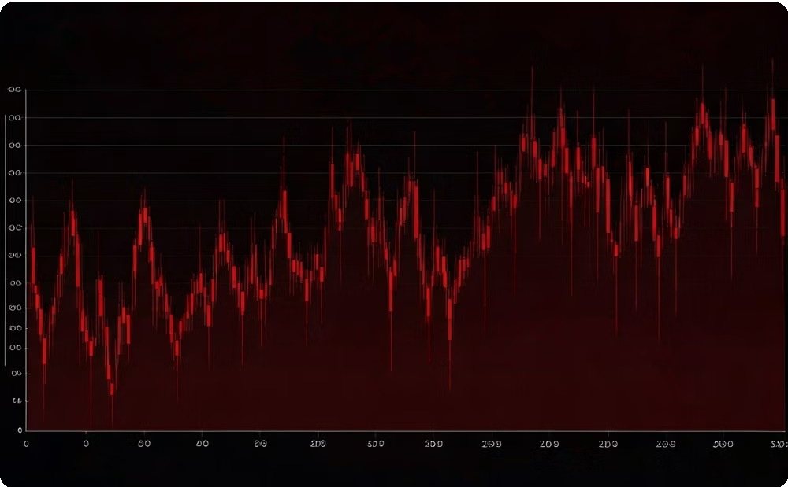
Data Visualization for Impact
Bar Charts
Comparisons and performance trends.
Scatter Plots
Relationships and correlations between variables.
Time Series Forecast
For predicting a future variable based on historical data

Slide 3
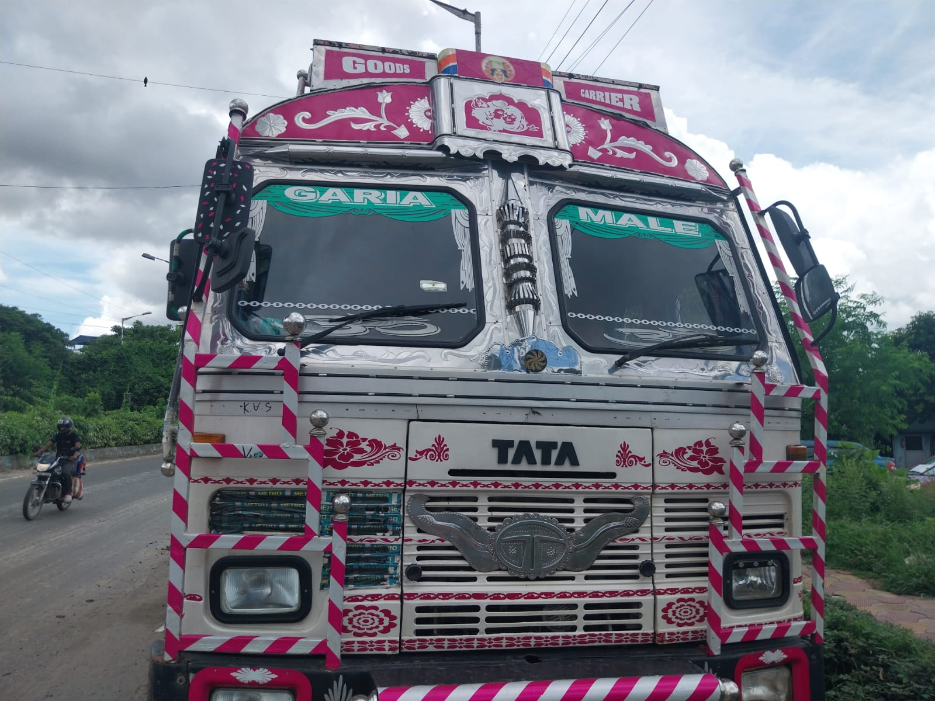
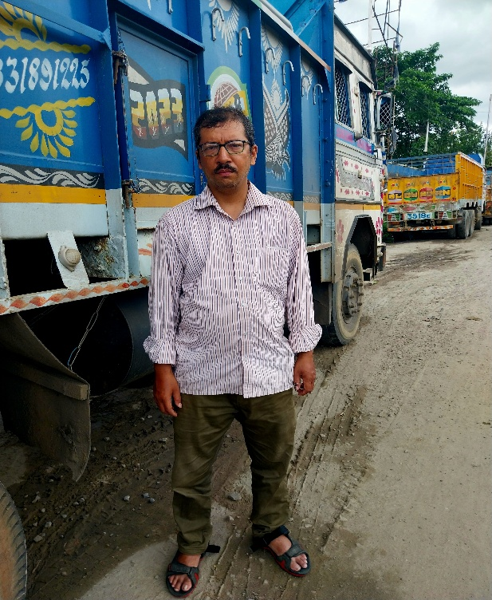
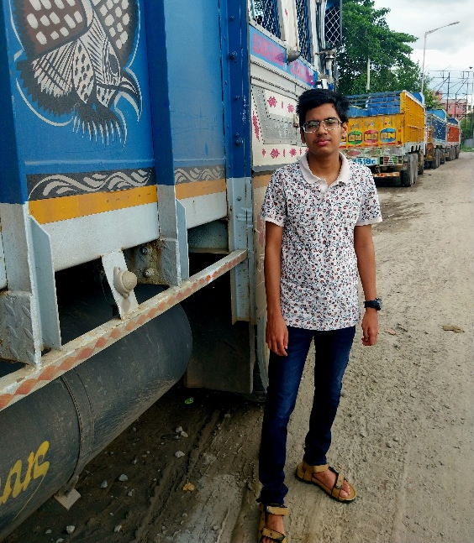
Organization Background
Name of the organization: Ganesh Transport
Location – 12/13 Padma Pukur Road, Kolkata – 700092
Established – 2019
Brief Background - Ganesh Transport, a small B2B transport company based in Kolkata and operated between Kolkata and Guwahati, faces significant operational challenges that are affecting its profitability. The company's fleet, consisting of a 6-wheeler and a 12-wheeler truck, has been plagued by issues such as goods damage during transit and delays in order fulfilment.

Slide 4
Defining the Business Problem
The dataset, spanning five months, includes metrics like cost, damage, oil price, and profit. The goal is to analyze and visualize these relationships using statistical methods and time series forecasting to predict future trends.
By addressing key challenges—goods damage, rising costs, and profit volatility—the analysis highlights inefficiencies and provides actionable insights.
These methods transform raw data into strategies that improve operational efficiency, reduce costs, and enhance profitability, offering a comprehensive understanding of how key factors interact in Ganesh Transport's operations.
Operational Inefficiencies: Cost spikes caused by maintenance issues, fluctuating labor costs, and delays due to driver fatigue.
Goods Damage: Moderate but frequent goods damage during transit, especially during adverse weather.
Profit Volatility: Inconsistent profit margins driven by unpredictable external factors and operational inefficiencies.

Slide 5
Data Collection
Data Collection and Cleansing:
➢ Gathered historical data on goods damage, weather patterns, and transit routes during the monsoon season.
➢ Cleaned and preprocessed data to ensure accuracy and consistency, removing outliers and handling missing values.
➢ Collected historical data on oil, operational expenses, delays, damages incurred and so on.
Throughout this period, my data collection approach involved a combination of daily visits with the manager and strategically timed alternate-day visits, allowing me to compile a comprehensive set of cumulative data encompassing the entire time span.
To address the issues, the project will implement a comprehensive data collection and analysis plan. Data will be gathered over a 5-month period to capture information on weather patterns, transportation routes, delivery times, and instances of goods damage. The data collection process will involve manual logging by drivers and manager himself. The collected data will be analyzed using a variety of analytical tools and techniques, including statistical analysis to determine the key factors contributing to delays, and predictive modelling to forecast transportation costs. Additionally, graphical techniques will be employed to establish optimal pricing strategies based on the insights gained. By systematically addressing the root causes of operational inefficiencies, this project aims to enhance Ganesh Transport's profitability, reduce transportation costs, and improve overall service delivery, ultimately positioning the company as a more competitive player in the transport sector.

Slide 6
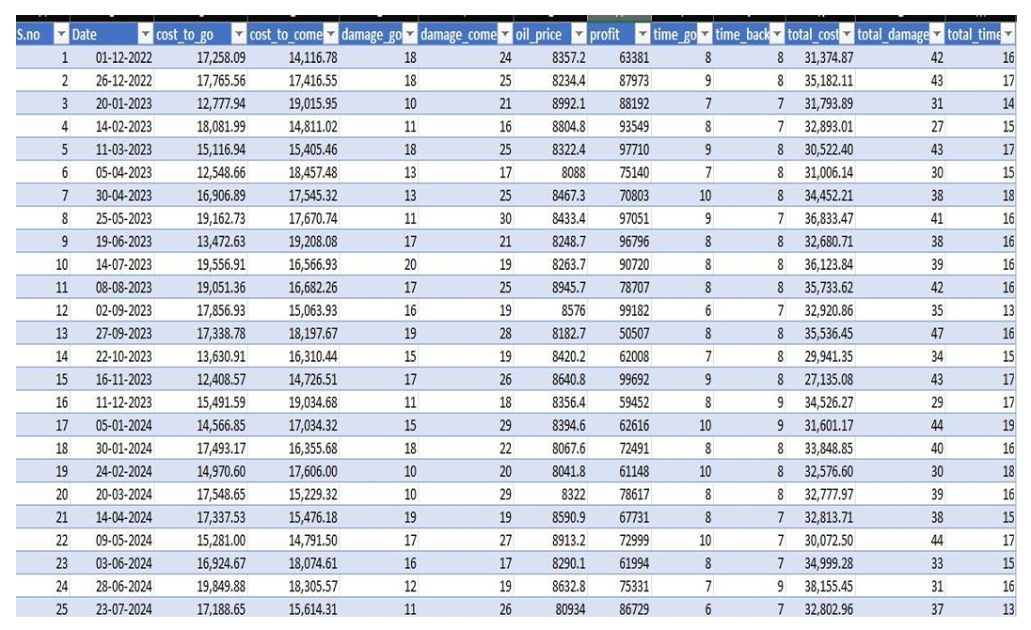
Metadata
➢ Date – The date of start of travel
➢ cost_to_go – Expenses Incurred while going to Guwahati, Assam (in Rs.)
➢ cost_to_come – Expenses incurred while coming back to Kolkata, West Bengal
➢ damage_go - Number of goods/packages damaged on going
➢ damage_come – Number of goods/packages damaged while coming
➢ oil_price - Total amount spend for a round trip on oil (in Rs.)
➢ profit – Total profit for one round trip (in Rs.)
➢ time_go _ Time Taken to go (days)
➢ time_back – Time taken to come back (days)

Slide 7

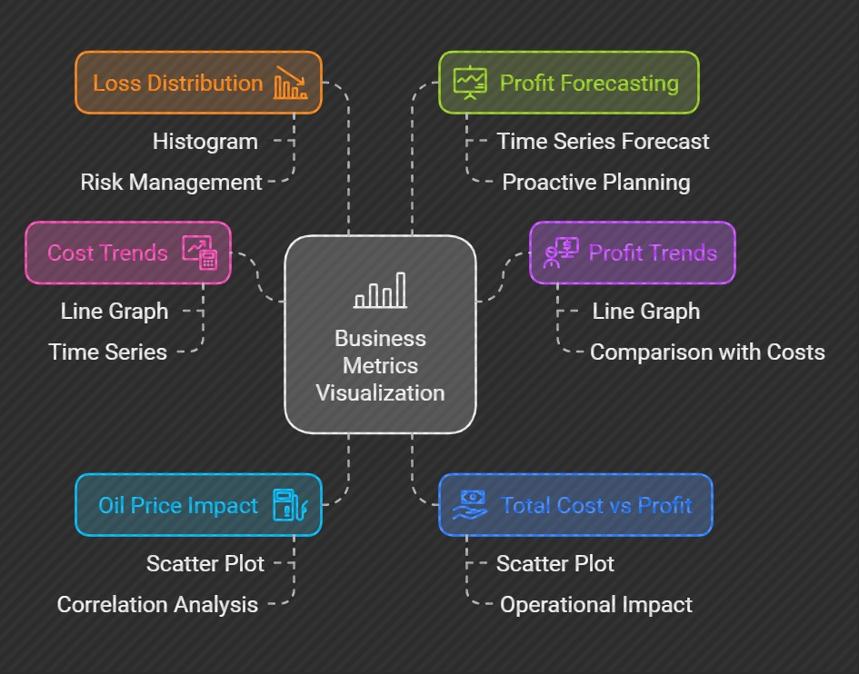
Statistical Modelling

Slide 8
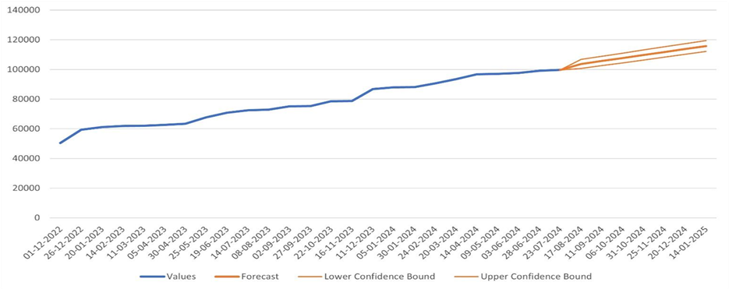
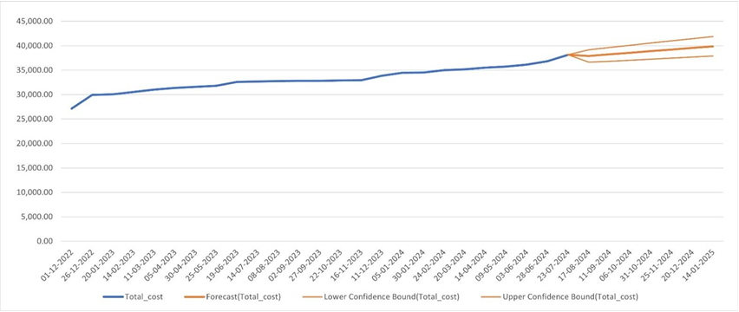
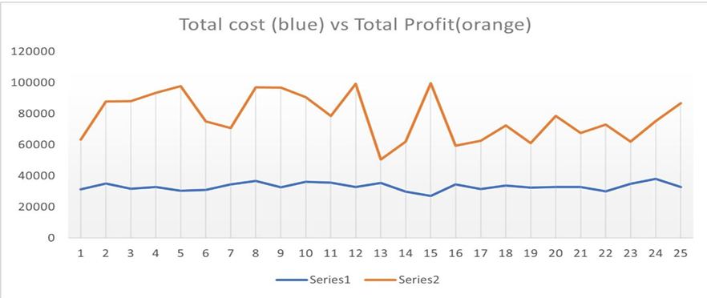
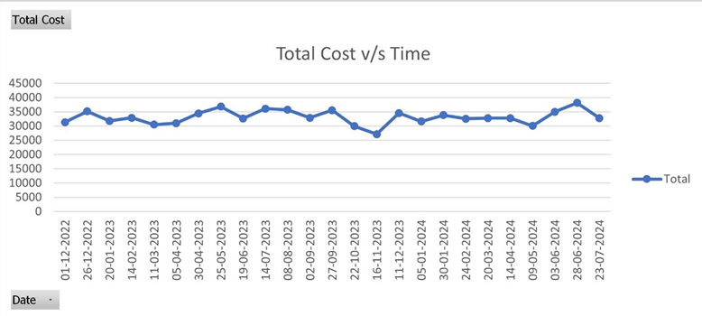
Total Profit Forecast
Total Cost Forecast

Slide 9
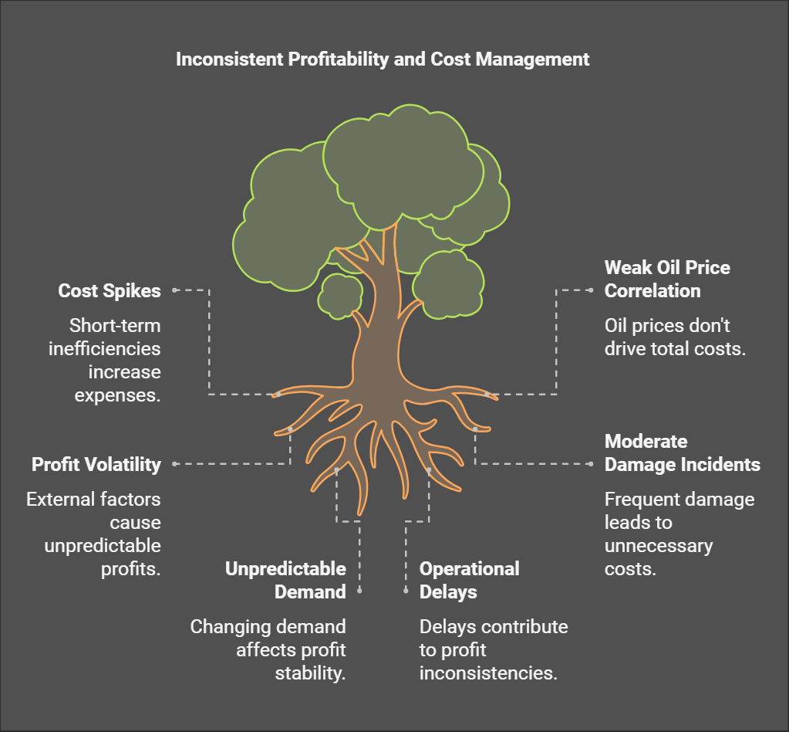

Slide 10
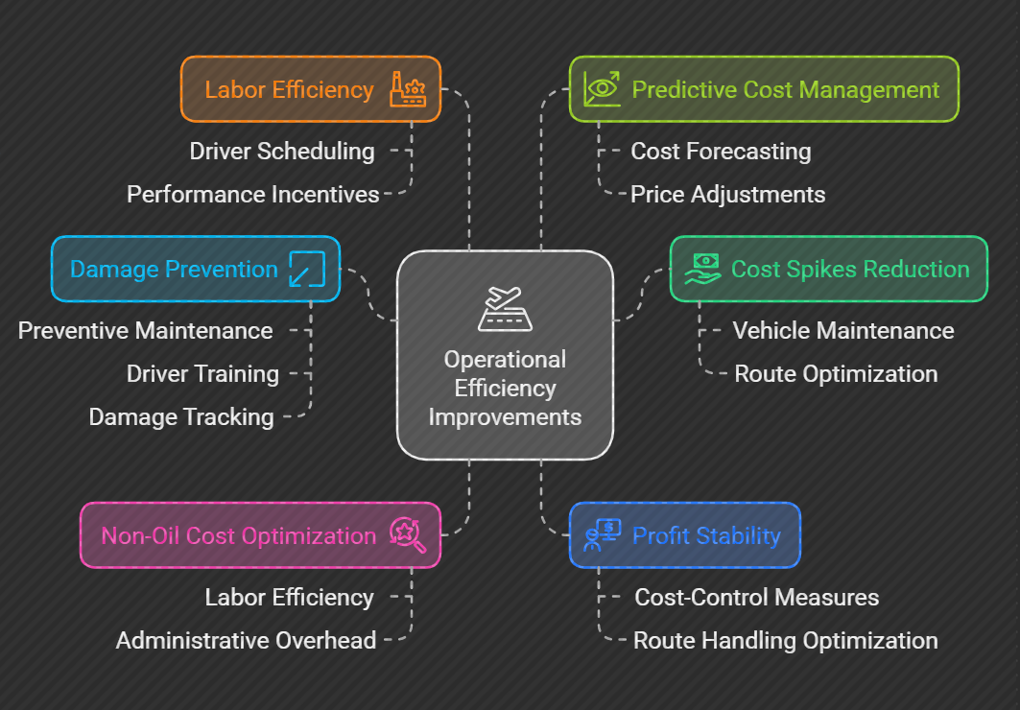

Slide 11
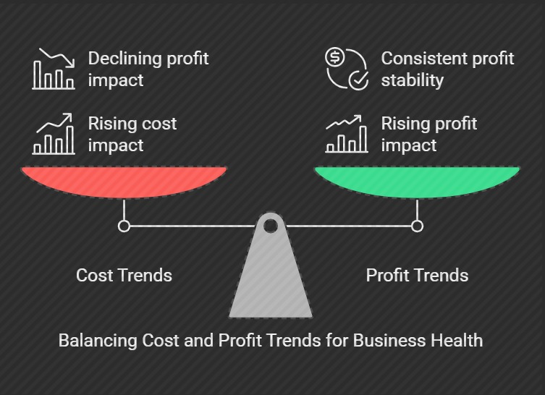
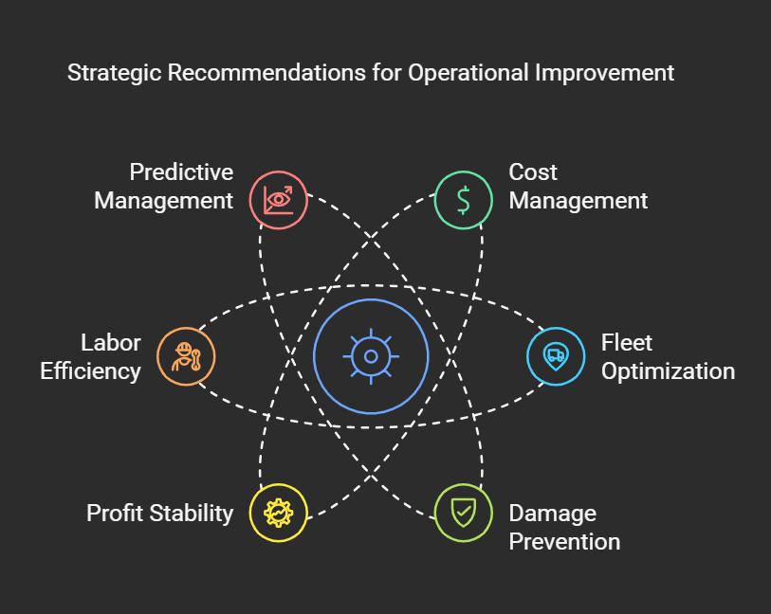

Slide 12
Thank You !!
by Shusmit Sarkar ( 23f3002196 )

